Slide 1
JS stream

Slide 2


Teachers
Rita Budavičiūtė
Martynas Bieliakas

Slide 3
Course agenda
Introduction to HTML, CSS
Introduction to JavaScript
DHTML - (AJAX, promises, some life examples and etc.)
Introduction to VUE (Angular...React...)

Slide 4
First lessons
Introduction to JavaScript course:
Internet history
Basic concepts - backend/frontend, server side/client side
Introduction to HTML + practical exercise
Introduction to CSS + practical exercise
Quick intro to JavaScript - how it can be used together with HTML.
These two lessons will be quick intro to web development and how everything works together afterwards Martynas will deep dive into JavaScript.

Slide 5





Tools

Slide 6
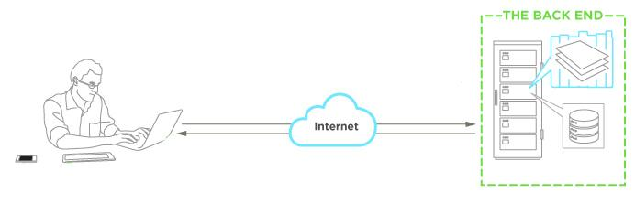
Front-end vs Back-end

Slide 7









Client-side vs Server-side

Slide 8
Client-side
The client-side environment used to run scripts is usually a browser.
The processing takes place on the end users computer.
The source code is transferred from the web server to the users computer over the internet and run directly in the browser.

Slide 9
Server-side
The server-side environment that runs a scripting language is a web server
A user's request is fulfilled by running a script directly on the web server to generate dynamic HTML pages. This HTML is then sent to the client browser

Slide 10
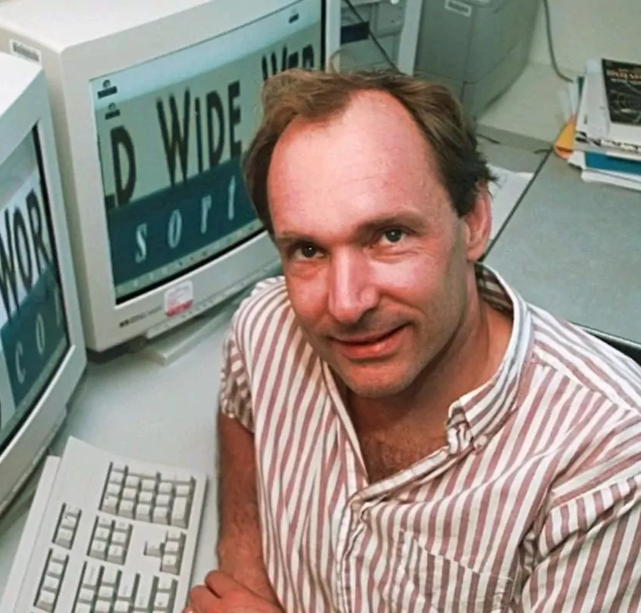
HTML history
1989 m. physicist Tim Berners-Lee invented the World Wide Web
1990 m. wrote the first web client

Slide 11
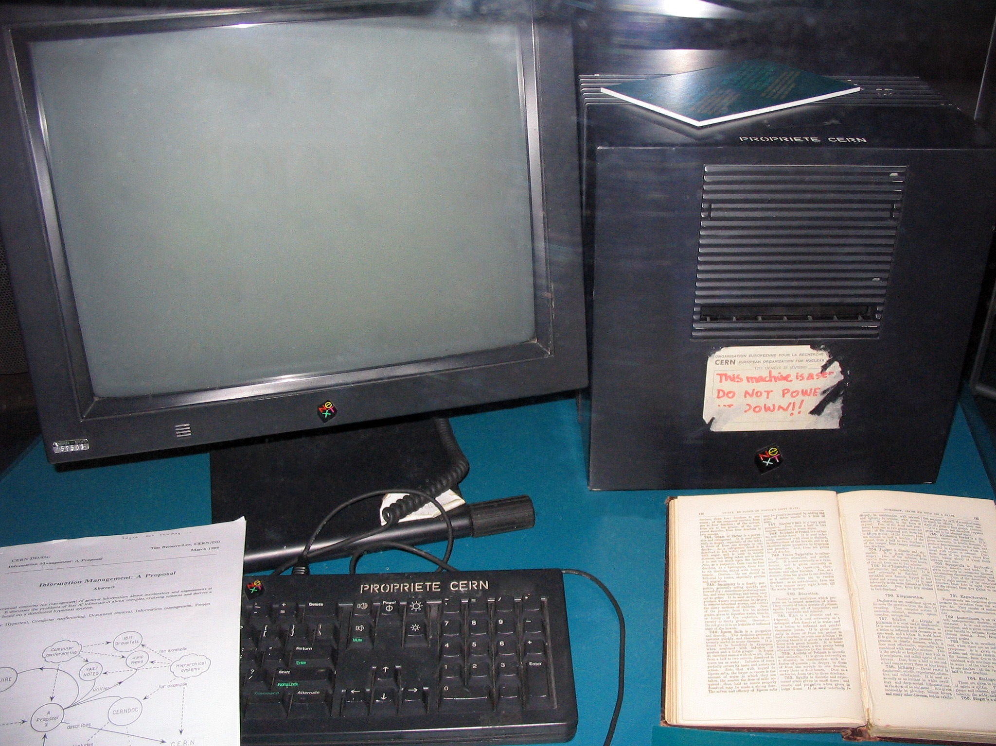
1991 first server was launched (CERN), the beginning of the internet as we know it now
First website http://info.cern.ch/

Slide 12
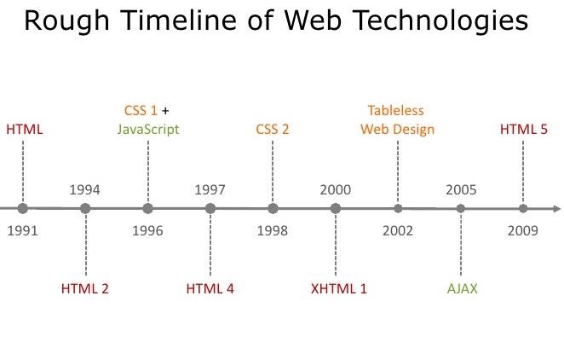

Slide 13
HTML
Hyper Text Markup Language
HTML is not a programming language
Code that is used to structure a web page and its content

Slide 14
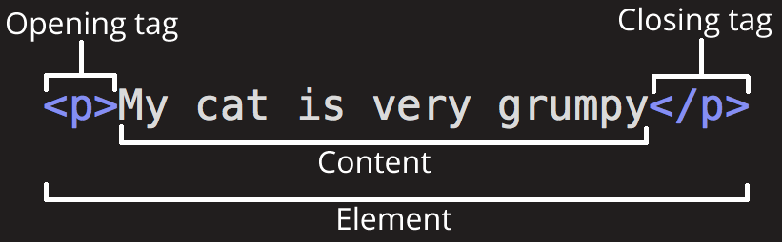
Tag
The main parts of our element are:
The opening tag
The closing tag
The content
The element

Slide 15
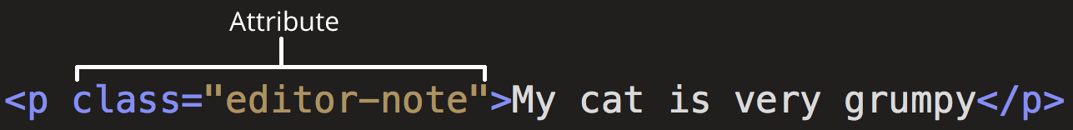
Attribute
Contains extra information about the element that you don't want to appear in the actual content
An attribute should always have:
A space between it and the element name
The attribute name, followed by an equals sign
Opening and closing quote marks wrapped around the attribute value

Slide 16
HTML documentation
World Wide Web Consortium (W3C)
Mozilla HTML documentation

Slide 17
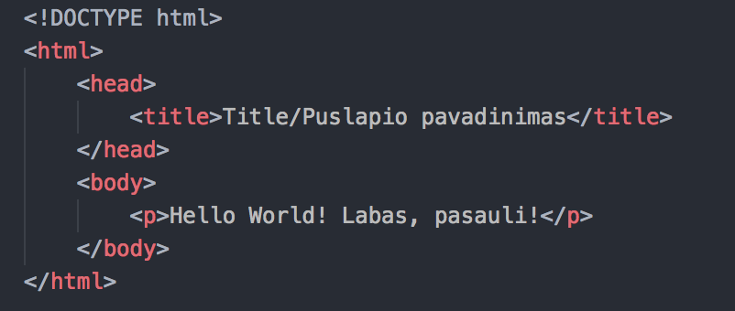
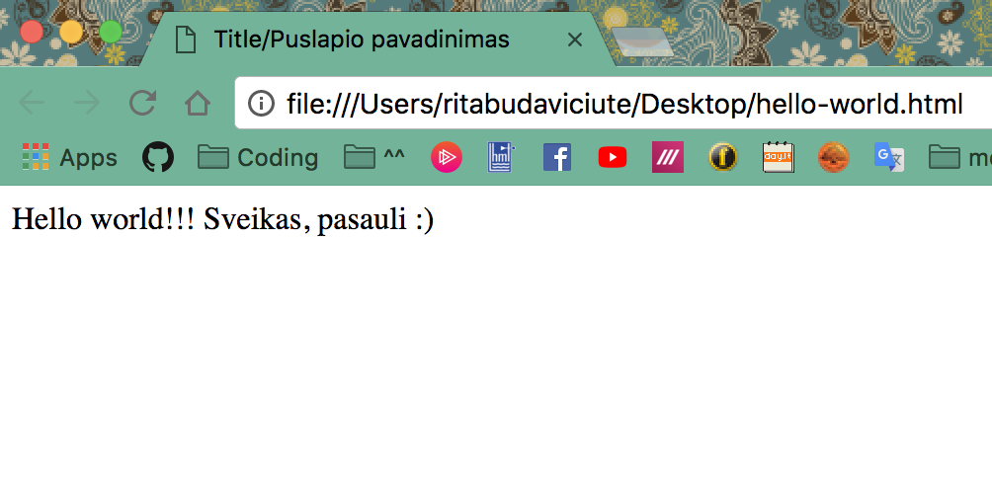
Hello world
Code looks like this:
That’s what we see in browser window:

Slide 18
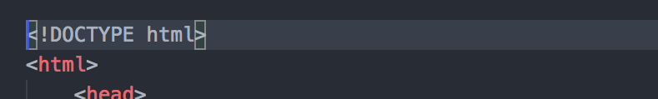
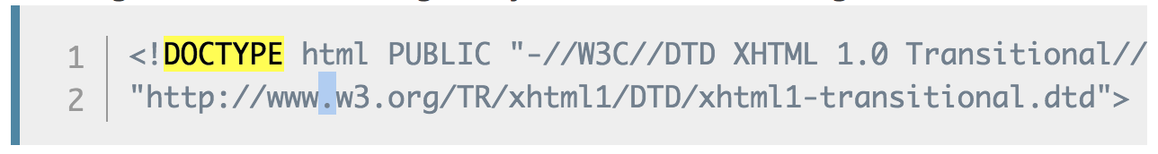
<!DOCTYPE html> tag
Doctypes were meant to act as links to a set of rules that the HTML page had to follow to be considered good HTML, which could mean automatic error checking and other useful things. They used to look something like this:

Slide 19
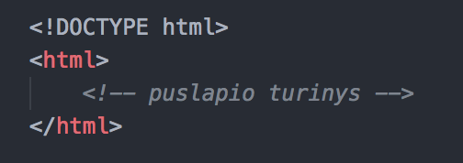
<html> tag
Wraps all the content on the entire page,
Sometimes known as the root element.

Slide 20
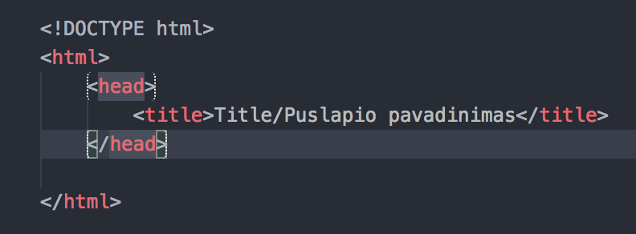
<head> tag
<head> - acts as a container for all the stuff you want to include on the HTML page that isn't the content you are showing to your page's viewers.
<title> - page title

Slide 21
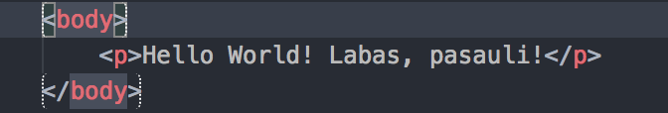
<body> tag
Contains all the content that you want to show to web users when they visit your page, whether that's text, images, videos, games, playable audio tracks, or whatever else

Slide 22
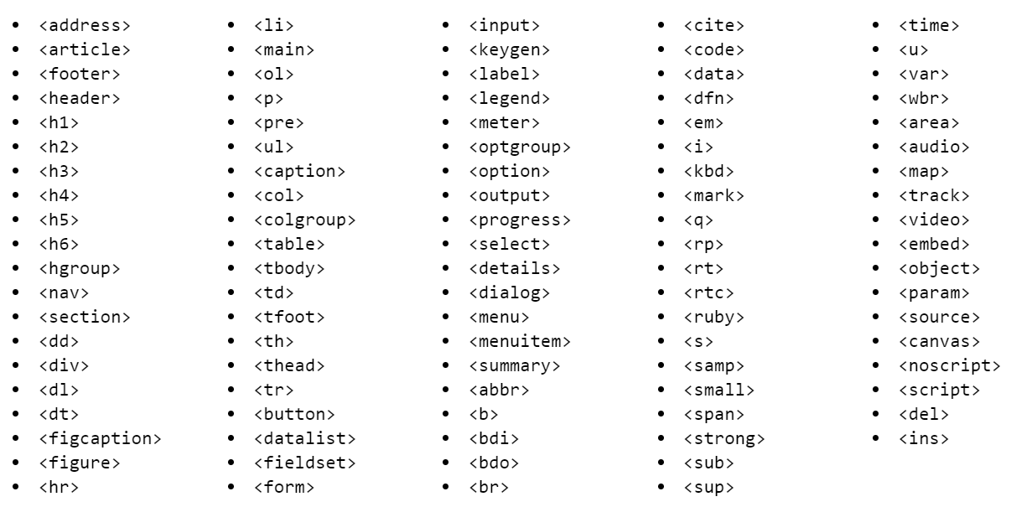

Slide 23
Main tags
You don’t have to remember all of them
Used most often:
<div>, <span>
<a href=””>
<h1> .. <h6>
<p>, <strong>, <i>, <em>
<ul>, <ol>, <li>
<button>
<form>, <input>, <textarea>, <label>

Slide 24
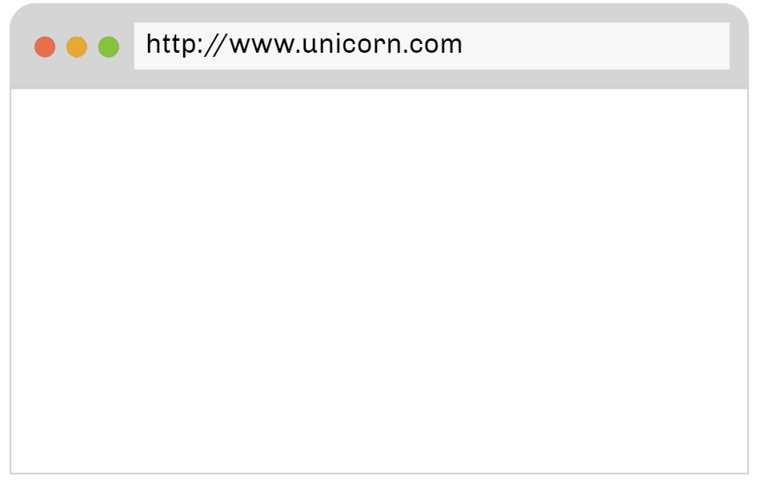
From top to bottom, left to right

Slide 25
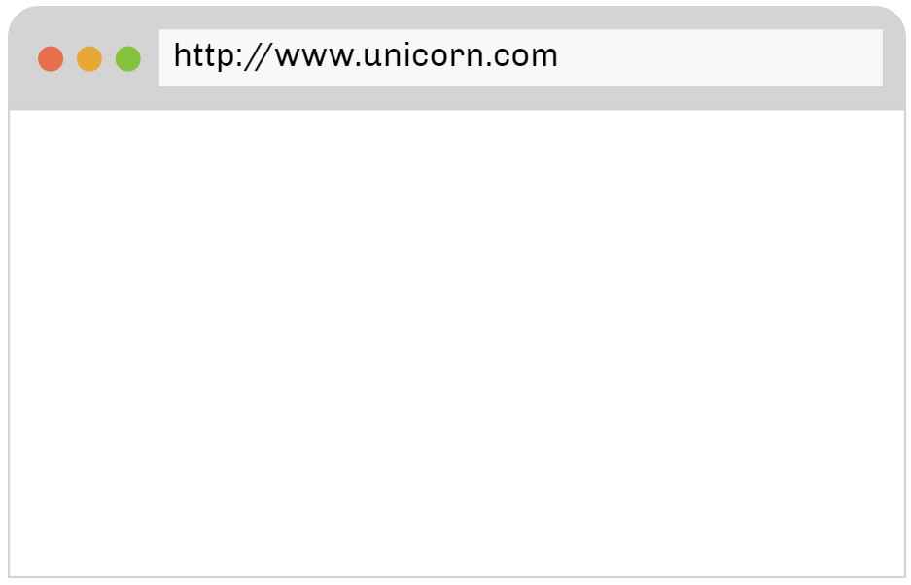
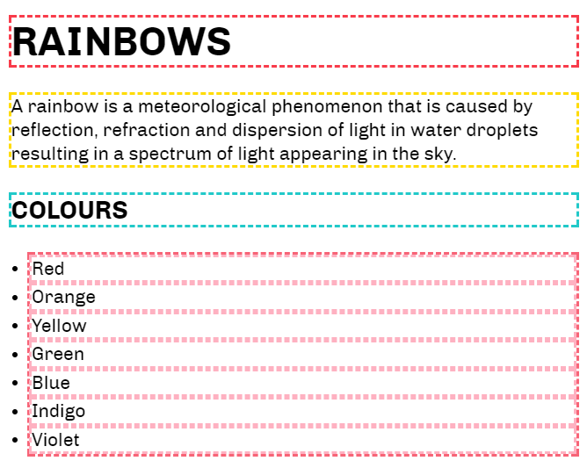
Block elements
Will appear on a new line from whatever content went before it, and any content that goes after it will also appear on a new line.
Headers <h1>, <h2> ..
Paragraphs <p>
Lists <ul>, <li>

Slide 26
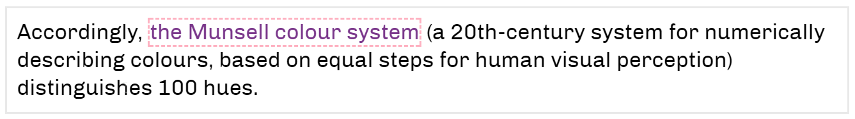
Inline elements
Contained within block-level elements and surround only small parts of the document’s content
Will not cause a new line to appear in the document
Link <a>
Input fields <input>
Images <img>

Slide 27
First exercise
Create a new folder on your desktop
Add new file “index.html”
Open it with vs code or notepad
Let’s create a web page with these elements:
A header <h1>, <h2>, ...
Paragraph <p></p>
A link to another page <a></a>
An image <img />
A list <ul>, <ol>
No worries!!! We will do it together :)
Also this documentation can help you - https://developer.mozilla.org/en-US/docs/Web/HTML

Slide 28

Github

